Slide 2
Digital Forensics Lecture-28
By- Dr.subhranil Das
Assistant Professor
School of computer Science

Slide 3

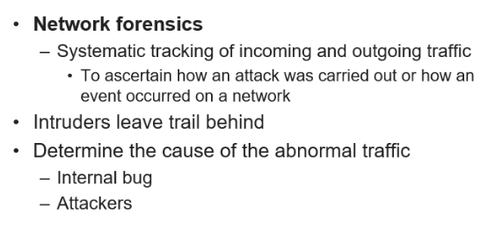
Network Forensics

Slide 4
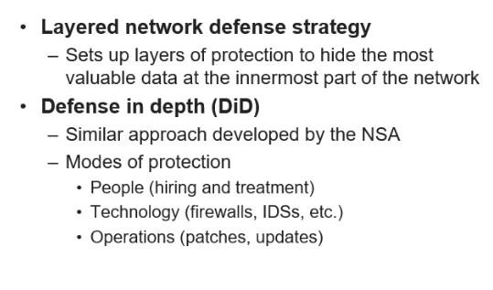
Securing the Network

Slide 5
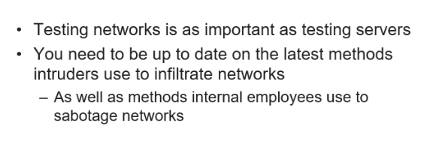
Securing the Network

Slide 6
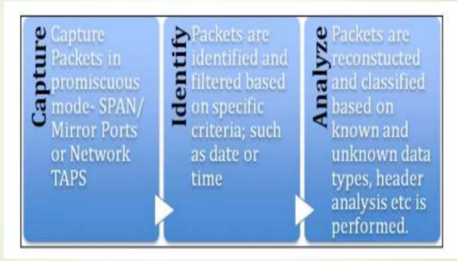
CIA for Network Forensics

Slide 7
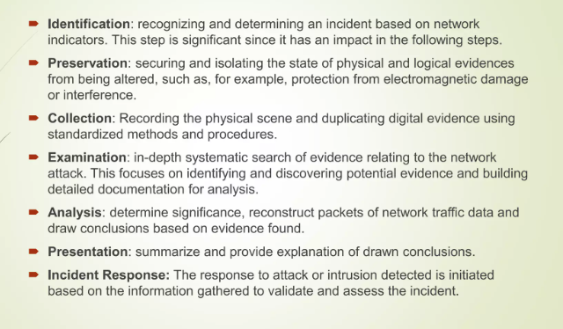
Process for Network Identification

Slide 8
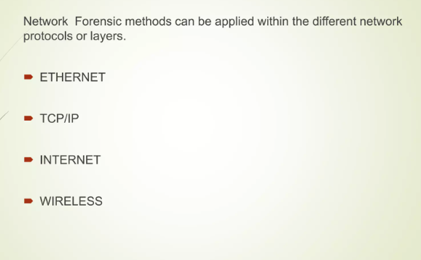
Network Forensics Tools

Slide 9
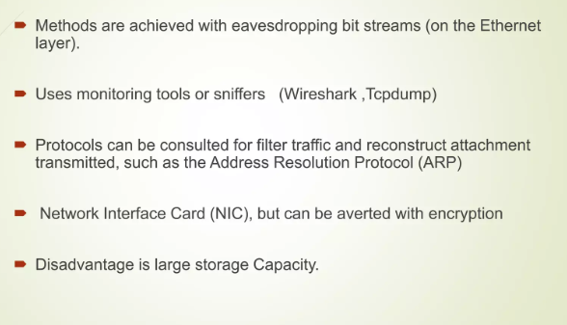
EtherNet

Slide 10
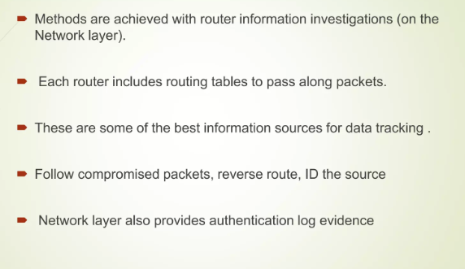
TCP/IP

Slide 11
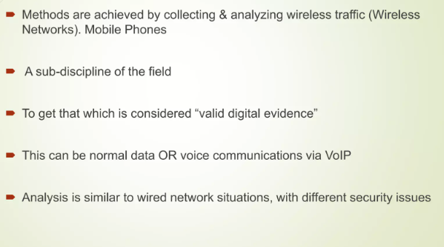
Wireless Forensic

Slide 12
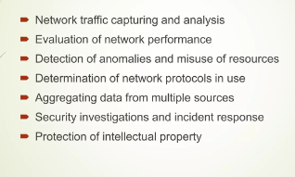
Functions of Network Analysis Tools

Slide 13
Next Lecture
Network Forensics
.

